Slide 1
Model-based Integrated Planning and Control of Autonomous Vehicles using Artificial Potential Fields with uncertain environment
Mid-Term Presentation
Josyula Viswanath Das
15th February 2022

Slide 2
Introduction

Slide 3
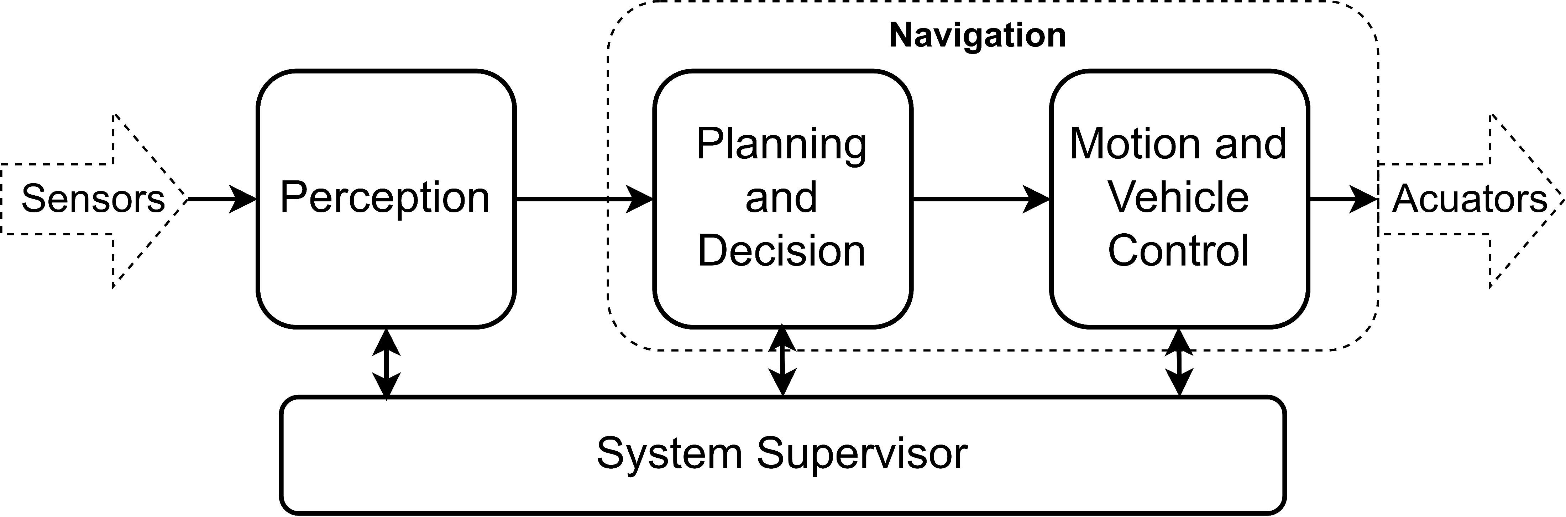
Introduction
The functional architecture of an AV can be divided into¹ :
¹ G. Velasco-Hernandez, D. J. Yeong, J. Barry and J. Walsh, "Autonomous Driving Architectures, Perception and Data Fusion: A Review," 2020 IEEE 16th International Conference on Intelligent Computer Communication and Processing (ICCP), 2020, pp. 315-321, doi: 10.1109/ICCP51029.2020.9266268.
Notes:
Speak about how the environment map is represented and also the presence of noise in the measurements due to calibration error, environmental changes, lack of exact noise/sensor models etc. Here map only contains obstacle size, position, velocity and maybe angle

Slide 4
Introduction
The functional architecture of an AV can be divided into¹ :
Perception – Sensor Data as input, the environment map,
localization and mapping as output.
Planning and Decision – Environment map along with rules,
user input, world status etc., as input and the final planned
path as an output
Motion and Vehicle Control – Consists of a tracking controller
which takes planned path as input and actuator input as its output
System Supervisor – Monitors the hardware and software components
and is designed to act as a safety critical system.
¹ G. Velasco-Hernandez, D. J. Yeong, J. Barry and J. Walsh, "Autonomous Driving Architectures, Perception and Data Fusion: A Review," 2020 IEEE 16th International Conference on Intelligent Computer Communication and Processing (ICCP), 2020, pp. 315-321, doi: 10.1109/ICCP51029.2020.9266268.
Notes:
Speak about how the environment map is represented and also the presence of noise in the measurements due to calibration error, environmental changes, lack of exact noise/sensor models etc. Here map only contains obstacle size, position, velocity and maybe angle

Slide 5
Introduction
The functional architecture of an AV can be divided into¹ :
Perception – Sensor Data as input, the environment map,
localization and mapping as output.
Planning and Decision – Environment map along with rules,
user input, world status etc., as input and the final planned
path as an output
Motion and Vehicle Control – Consists of a tracking controller
which takes planned path as input and actuator input as its output
System Supervisor – Monitors the hardware and software components
and is designed to act as a safety critical system.
¹ G. Velasco-Hernandez, D. J. Yeong, J. Barry and J. Walsh, "Autonomous Driving Architectures, Perception and Data Fusion: A Review," 2020 IEEE 16th International Conference on Intelligent Computer Communication and Processing (ICCP), 2020, pp. 315-321, doi: 10.1109/ICCP51029.2020.9266268.
Notes:
Speak about how the environment map is represented and also the presence of noise in the measurements due to calibration error, environmental changes, lack of exact noise/sensor models etc. Here map only contains obstacle size, position, velocity and maybe angle

Slide 6
Introduction
The functional architecture of an AV can be divided into¹ :
Perception – Sensor Data as input, the environment map,
localization and mapping as output.
Planning and Decision – Environment map along with rules,
user input, world status etc., as input and the final planned
path as an output
Motion and Vehicle Control – Consists of a tracking controller
which takes planned path as input and actuator input as its output
System Supervisor – Monitors the hardware and software components
and is designed to act as a safety critical system.
¹ G. Velasco-Hernandez, D. J. Yeong, J. Barry and J. Walsh, "Autonomous Driving Architectures, Perception and Data Fusion: A Review," 2020 IEEE 16th International Conference on Intelligent Computer Communication and Processing (ICCP), 2020, pp. 315-321, doi: 10.1109/ICCP51029.2020.9266268.
Notes:
Speak about how the environment map is represented and also the presence of noise in the measurements due to calibration error, environmental changes, lack of exact noise/sensor models etc. Here map only contains obstacle size, position, velocity and maybe angle

Slide 7
Introduction
The functional architecture of an AV can be divided into¹ :
Perception – Sensor Data as input, the environment map,
localization and mapping as output.
Planning and Decision – Environment map along with rules,
user input, world status etc., as input and the final planned
path as an output
Motion and Vehicle Control – Consists of a tracking controller
which takes planned path as input and actuator input as its output
System Supervisor – Monitors the hardware and software components
and is designed to act as a safety critical system.
¹ G. Velasco-Hernandez, D. J. Yeong, J. Barry and J. Walsh, "Autonomous Driving Architectures, Perception and Data Fusion: A Review," 2020 IEEE 16th International Conference on Intelligent Computer Communication and Processing (ICCP), 2020, pp. 315-321, doi: 10.1109/ICCP51029.2020.9266268.
Notes:
Speak about how the environment map is represented and also the presence of noise in the measurements due to calibration error, environmental changes, lack of exact noise/sensor models etc. Here map only contains obstacle size, position, velocity and maybe angle

Slide 9
Introduction
Each block runs an algorithm which is not influenced by the other algorithms.
This can lead to lack of compatibility between the blocks leading to the not satisfying the requirements or cause a collision.

Slide 10
Path Planning
Path planning is the process of finding a collision-free motion of a robot/vehicle from a given start position to a given position. There are two kinds of path planning
Global Path Planning - A global path planning algorithm assumes that the environment model (the shape and location of the obstacle) is completely known. It then performs a search to find the best route from a start position to the goal position.
Local Path Planning – A local path planning algorithm assumes that the environmental model is unknown. The robot/vehicle therefore get environmental data from its sensors to generate a local environmental map through which it plans a collision free path. The path generated through this dynamic environment.
In this thesis we concentrate on local path planning.

Slide 11
Path Planning
Examples of local path planning algorithms are
Bug Algorithm - The robot/vehicle follow a straight line between the start and the goal and follows the contour of the obstacle when encountering an obstacle
Potential Fields – The obstacles are defined by a repulsive potential and the goal by an attractive potential. The minimum potential path if then found using the gradient descent method.
Optimization based methods – The path planning is defined as an optimization problem considering the vehicle dynamics and appropriate constraints. The constraints can represent both the obstacles and the constraints on the states of the robot/vehicle. The objective function encodes specifications to be fulfilled by the desired path.
The advantages of optimization-based path planning algorithms are
The ease of addition of trajectory smoothening by using the system dynamics as a constraints as well as a cost. Other cost can also be easily added.
Easy of addition of constraints on both the environment (for collision avoidance) as well as the robot/vehicle
Results in a path planned which can be tracked well.

Slide 12
Path Planning
Model Predictive Control approach to path planning is one such optimization based online path planning method. MPC solves a sequence of finite time optimization problems at each time step and can update its environment during its planning process.

Slide 13
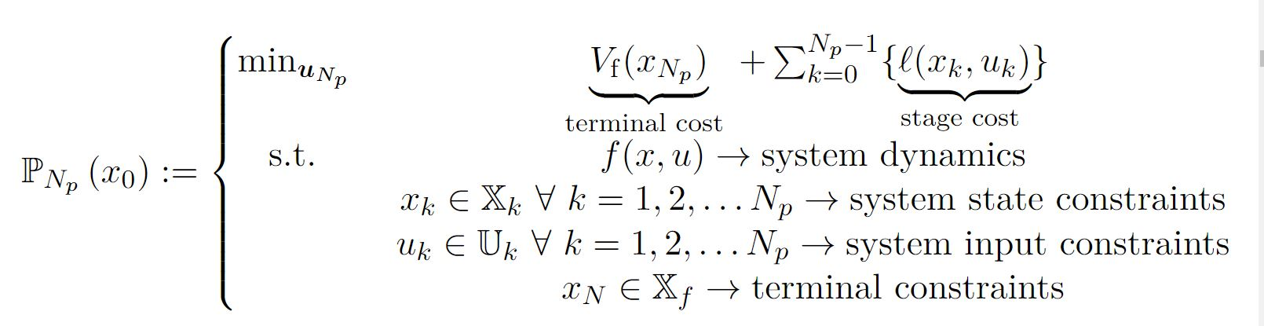
Model Predictive Control(MPC)
MPC uses a prediction model and an optimization algorithm to predict the future evolution of the system using the prediction model and to use the optimization algorithm to calculate the optimal control input set to reach the desired state within the given horizon. Having calculated the optimal control input set, the first control input is applied to the actual plant. This process runs recursively.
Because MPC is an online computation method, it requires high computational power and requires an accurate prediction model.

Slide 14
Integration of Planning and Vehicle Control using MPC
The integration of the path planning and decision and the vehicle motion and control block can therefore lead to
Better performance of the navigation task
Improvement in fulfilling control criteria if any
Collision avoidance
Generation of feasible paths
It is also a good idea to combine path planning and the vehicle motion and control block as it reduces the chance of incompatibility.
Model Predictive Control is widely used

Slide 15
Different approaches to integrated Planning and Vehicle Control using MPC
Multiple ways of integrating path planning and tracking using an MPC have be discussed in literature
MPC as an optimization-based planner by replanning a path generated by a global path planner.
Path planning using MPC and parametric curves –MPC adds the parametric path to the objective function of the MPC optimization problem by
Rewriting the parametric path as a function of the input
Assuming the parametric path to be generated by a reference system and using the error model as the system model of the MPC optimization problem.
Path Planning using MPC and Artificial Potential Field (APF)
Notes:
– This done to both for trajectory smoothening as well as to avoid dynamic obstacles. In case an obstacle is encountered, the global path is replanned and provides MPC with new waypoints to follow
In this method, an artificial potential is added to the objective function of the system to add collision avoidance. The minimization problem finds the minimum potential path through the obstacles.

Slide 16
Different approaches to integrated Planning and Vehicle Control using MPC
This thesis choses the MPC + APF method for integrating Artificial Potential Fields as APF’s can be designed based on the requirements of the system model (for example to maintain safe driving distance between vehicles, aid in lane change etc.)
Advantages:

Slide 17

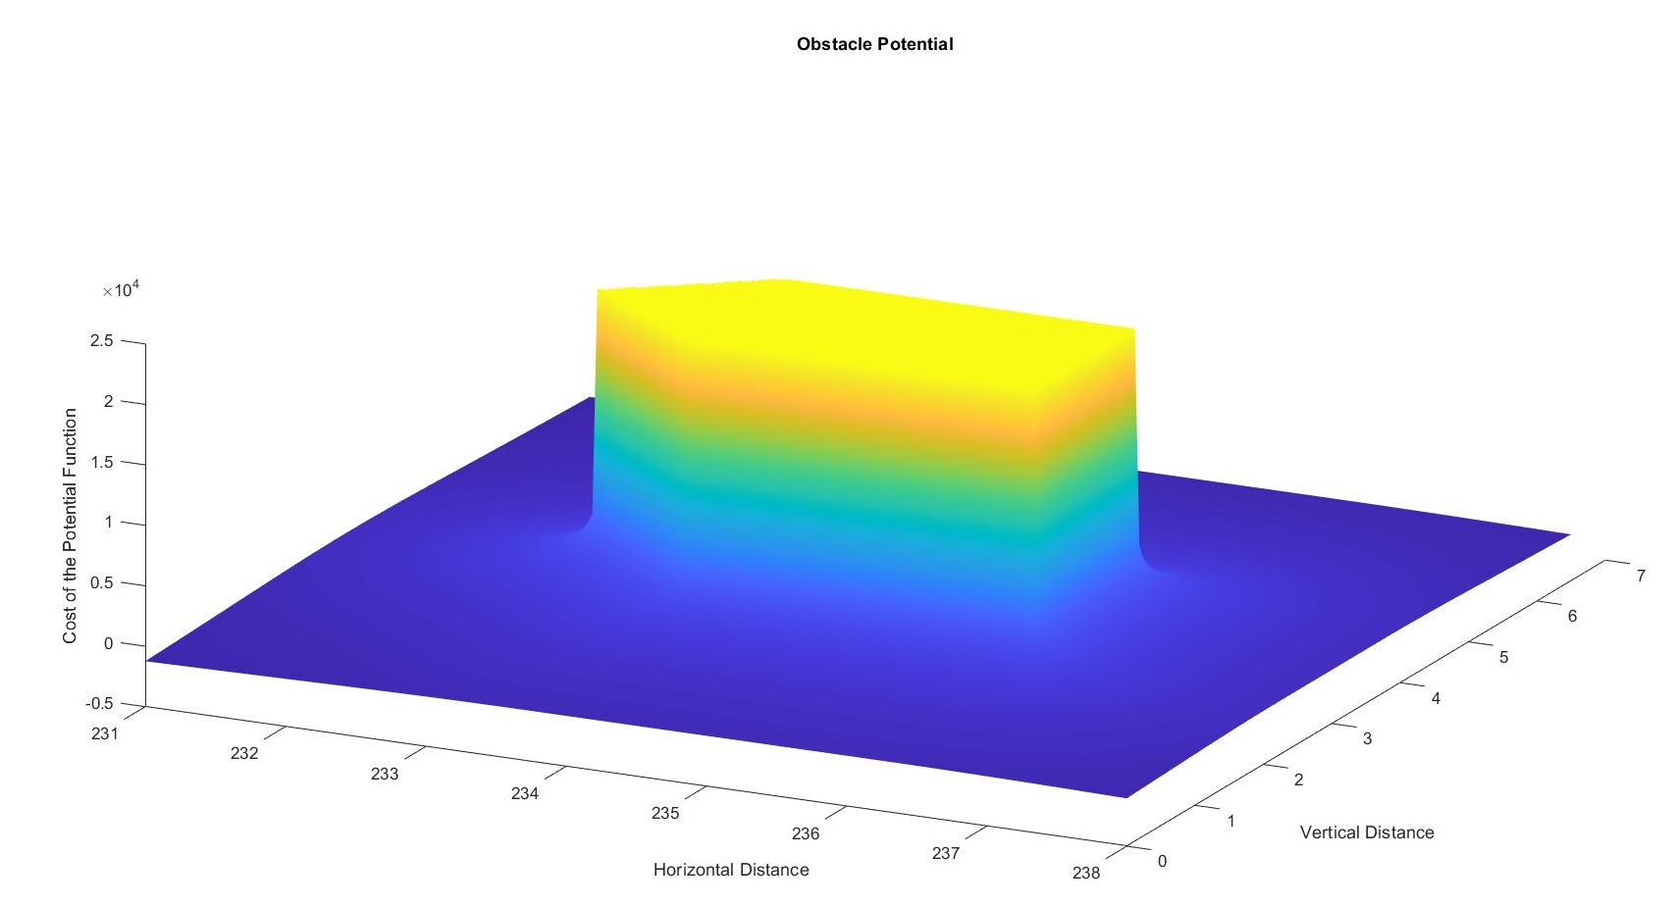



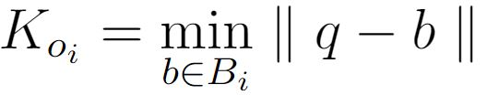



Design of the APF
Two different repulsive potentials were designed to keep the robot/vehicle for collision avoidance and path planning.
Obstacle Potential – A modified Yukawa potential is used to represent the obstacles as shown below
where and are constants and is the Euclidian distance between the center of the robot/vehicle and the closest point on the obstacle and is given by
is the position of the robot/vehicle and is the set of points representing the obstacle and represent the i^{th} obstacle.

Slide 18
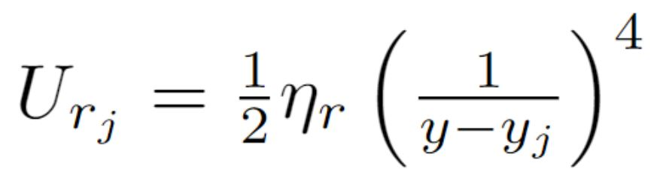
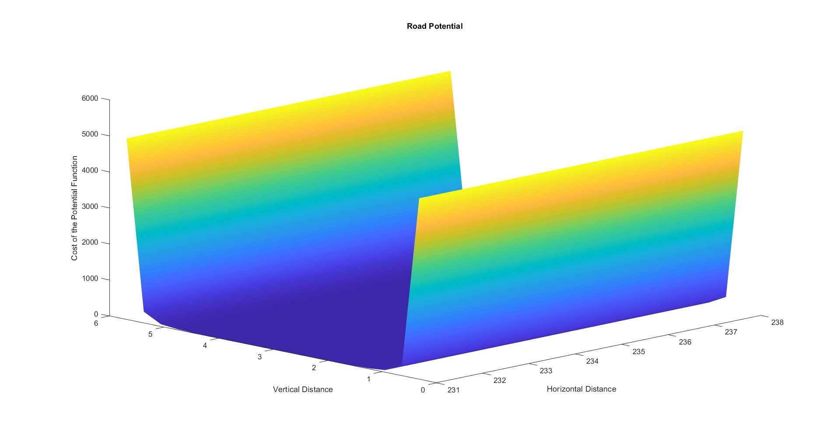




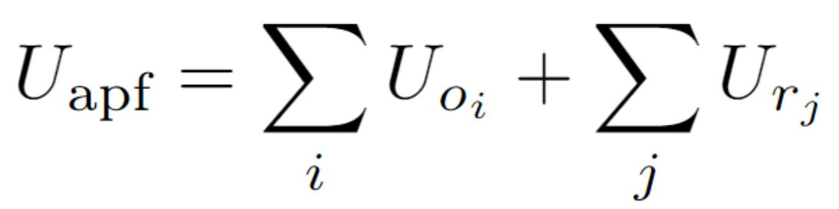
Design of the APF
Road Potential – A repulsive road potential is designed to be minimum near the center of the road and to be infinity near the edges of the road. This is to make sure the obstacle always stays within the road. The equation of the road is given by
The total APF is given by
where is the scaling factor, is the lateral position, is the road edge coordinate,

Slide 19
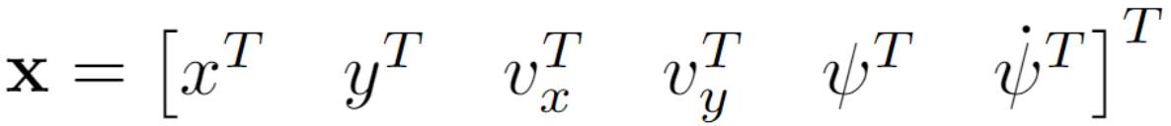
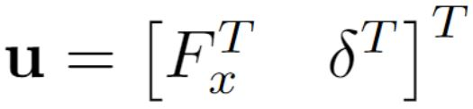
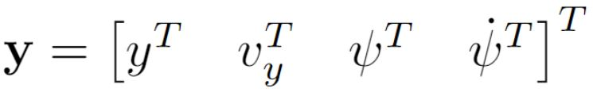
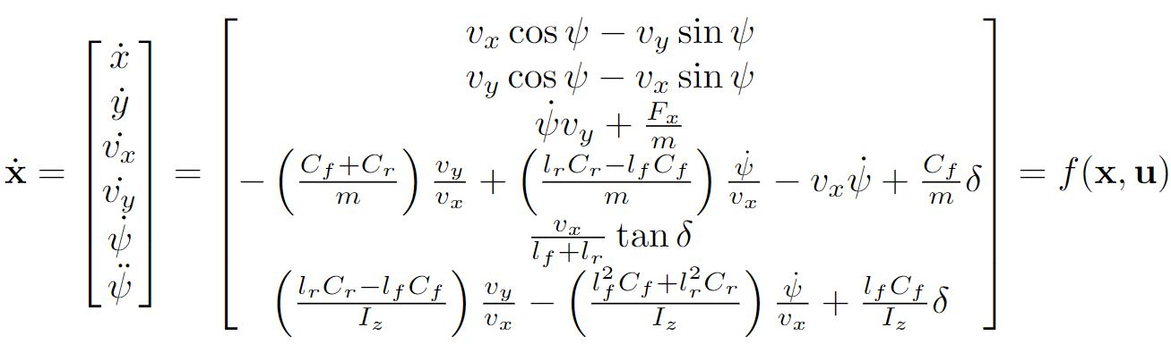
System Dynamics
A bicycle model of the vehicle with states ,input and output is used to define the system dynamics of the robot/vehicle and is given by

Slide 20
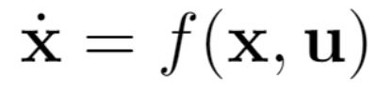
Convex MPC
As the system model is non- linear and the objective function is non-convex due to the presence of the potential fields, we turn the MPC optimization problem into a convex problem by
Linearizing at the current state and zero input to get a linear state space model
As the potential field are nonconvex, a quadratic Taylor Series approximation of the potential fields is obtained at the current state of the robot/vehicle.
The final MPC problem is a convex optimization problem which can be solved using available solvers.
Though a

Slide 22
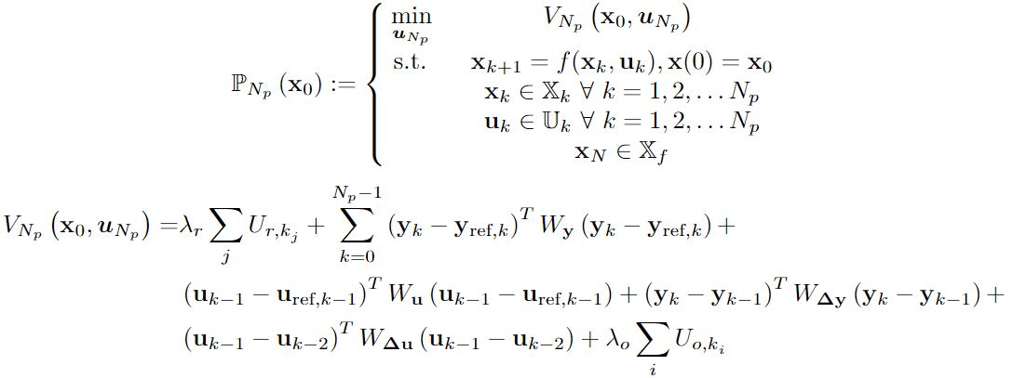
Design of MPC
Given the initial state of the robot/vehicle, the MPC optimization problem for integrated path planning and vehicle control is given by

Slide 23
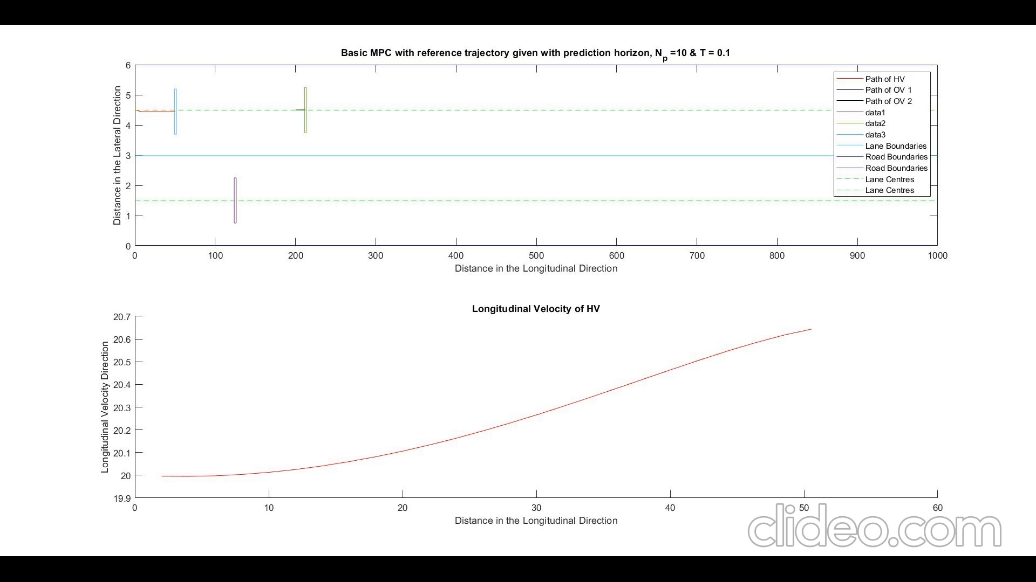
Results

Slide 24
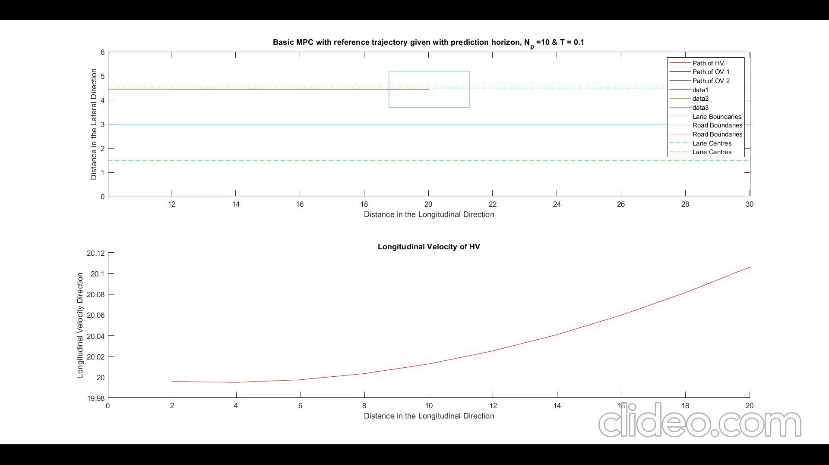

Slide 25

Next Steps
As the position data of the obstacles available to the robot/vehicle is mostly stochastic in nature, the thesis looks forward into the addition of stochasticity to the above designed MPC optimization problem.
This idea can be taken forward by using Robust Model Predictive Control (RMPC) techniques or Stochastic Model Predictive Control (SMPC) techniques.
As SMPC is less conservative than RMPC techniques, SMPC is decided to be implemented.
This can be done using an expectation based objective function or probabilistic constraints of the form
where is the confidence level, is a design parameter defining the trade-off between performance and constraint violation.

